Slide 1
USE Graphs ANALYTICS TO INDENTIFY THE BEST REVIEWED LISTINGS OF cAMBRIDGE, mA USA IN TERM OF PRICE GROUP AND NEIGBORHOOD
Network Science 6520
Xi Lin

Slide 2
Primary Objective:
Airbnb, Inc. is an American company founded in 2008 that operates an online marketplace for lodging (primarily homestays for vacation rentals) and travel activities. The platform is based in San Francisco, California, and is accessible through its website and mobile app. Airbnb does not own any of the properties listed; instead, it profits by collecting a commission from each booking. The emergence of Airbnb has contributed to a boom in tourism and improved the quality of travel.
This proposal is to apply graph query to identify and target below:
The best reviewed listings of Cambridge city in term of price group and neighborhood. Usually, the visitors or travelers are looking for the best available rental properties either by price range or location/neighborhood. This can be done via query by filters and orders, however, exploring graph could end up with more intuitive views and single hops.
1.Given a location (Neighborhood), show the listings in the best review score group, so I can consider them on higher priority.
2. Given a price (Price Group), show the listings within worst review score group, so I can avoid to book them.

Slide 3
Dataset & Business Use Case:
Data was acquired directly from Airbnb’s database for educational research purposes. The dataset we use in here is the listings and reviews data that is published by Airbnb per period per region. In US, the region usually is a city. Based upon the data volume requirement, we deliberately choose a town that has less data but good enough for demo purpose – we pick the listings and reviews data from Cambridge, MA USA as of March, 2021.
A general overview of the data set as follows (a dictionary is included in the Appendix for deeper review):
Listings / Listing Detail: Listing data for Cambridge, MA in terms of link, rental type, number of bedroom and restroom, accommodation, neighborhood, review counts and average ratings, default price, so on so force.
Calendar: Despite of its misleading name, this data provides the daily price (could vary) info upon each listing (a short window starting from March 2021).
Reviews / Review Detail: Provides the available historically review info upon each listing, it has listing id, date, reviewer, and comments. Surprisingly no rate score – this is for privacy purpose.
Neighborhood: this is a reference data set for neighborhood.

Slide 4
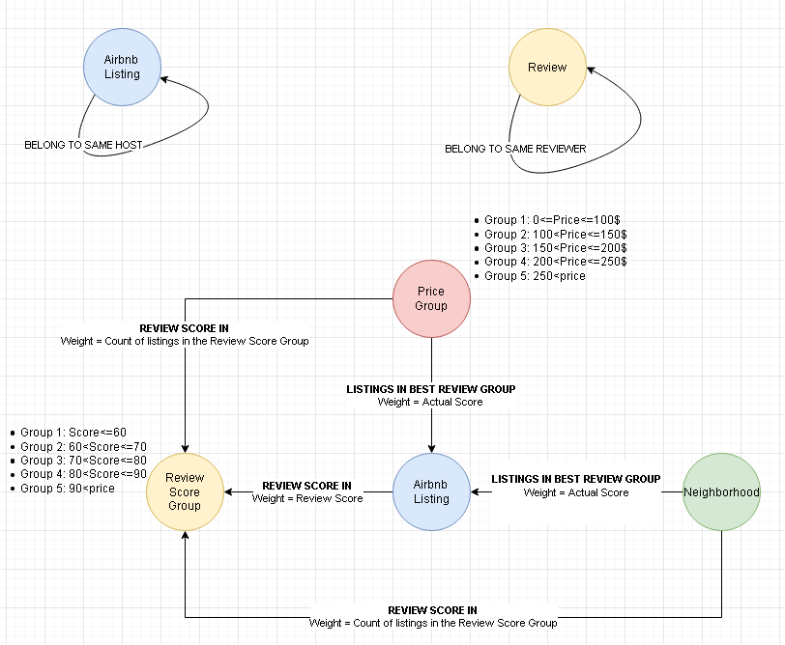
Draft Graph Data Model 1

Slide 5
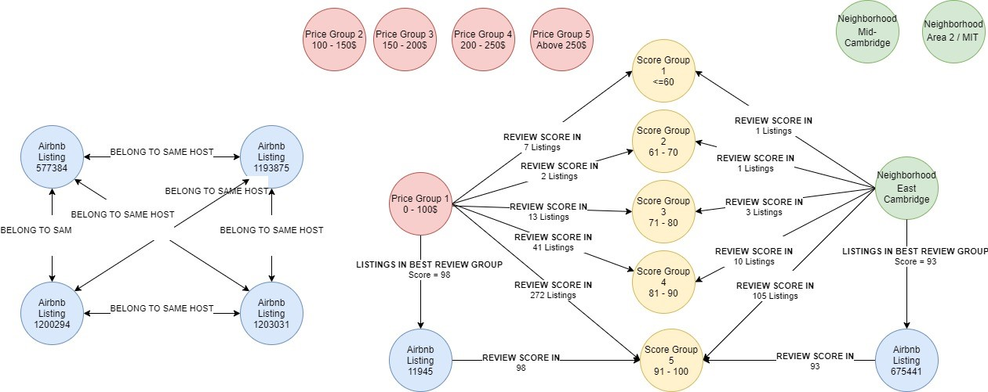
Graph Projections

Slide 6
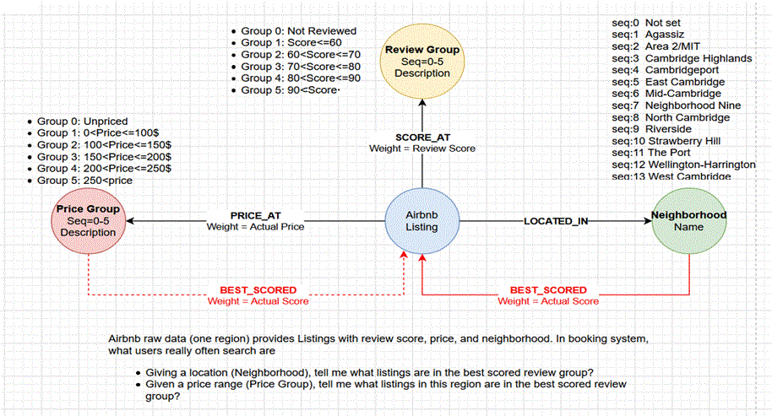
Final Data Model

Slide 7
Data preparation and cleaning
Download data from Airbnb data set: http://insideairbnb.com/get-the-data.html
There are some data issues about listings, if they are under deco or for a period not available on market, the price is missing. But we do not want to filter them out since they still have valid neighborhood information. I created a Group 0 in Price Group node to accommodate such situation, and link those missing price listings to this group.
There are some data issues about some listings with no review info – this is understood that if the listing never received any review which is allowed. I do not want to filter them out since they carry valid price information, so I create Group 0 in Review Group node to accommodate such situation and link those missing review listings to this group.
For the region in Cambridge MA, there is no listing that has missing neighborhood, but this could happen in other region if we apply this model to analyze other cities. Hence to be more flexible and accommodating, we created a node in Neighborhood called Not Set.
Why use group 0 for missing price or missing review? Because the group number is not only an ID, but also in its property “Seq” which is used to determine the max price or min review score etc., and Group 0 would throw them into the right place in sequence.

Slide 8
Data Load (Nodes)
(1) Review Group
CREATE CONSTRAINT pk_ReviewGroup ON (r:ReviewGroup) ASSERT r.seq IS UNIQUE;
LOAD CSV WITH HEADERS FROM 'file:///ReviewGroup.csv' AS row
WITH toInteger(row.seq) as v_seq, row.description as v_description
MERGE(S:ReviewGroup {seq: v_seq}) SET S.description=v_description RETURN COUNT(S);
# Query: MATCH(r:ReviewGroup) RETURN r;
# Delete: MATCH(r:ReviewGroup) DETACH DELETE r;
(2) Price Group
CREATE CONSTRAINT pk_PriceGroup ON (p:PriceGroup) ASSERT p.seq IS UNIQUE;
LOAD CSV WITH HEADERS FROM 'file:///PriceGroup.csv' AS row
WITH toInteger(row.seq) as v_seq, row.description as v_description
MERGE(P:PriceGroup {seq: v_seq}) SET P.description=v_description RETURN COUNT(P);
# Query: MATCH(p:PriceGroup) RETURN p;
# Delete: MATCH (n:PriceGroup) DETACH DELETE n;
(3) Neighborhood
CREATE CONSTRAINT pk_Neighbourhood ON (n:Neighbourhood) ASSERT n.seq IS UNIQUE;
LOAD CSV WITH HEADERS FROM 'file:///Neighbourhood.csv' AS row
WITH toInteger(row.seq) as v_seq, row.name as v_name
MERGE(N: Neighbourhood {seq: v_seq}) SET N.name=v_name RETURN count(N);
# Query: MATCH(n:Neighbourhood) RETURN n;
# Delete: MATCH(n:Neighbourhood) DETACH DELETE n;
(4) Listing
LOAD CSV WITH HEADERS FROM 'file:///Listing.csv' AS row
WITH toInteger(row.id) as ListingID, toInteger(row.host_id) as HostID, row.name as ListingName
MERGE(L:Listing {id: ListingID}) SET L.name=ListingName, L.host_id=HostID
RETURN COUNT(L);

Slide 9
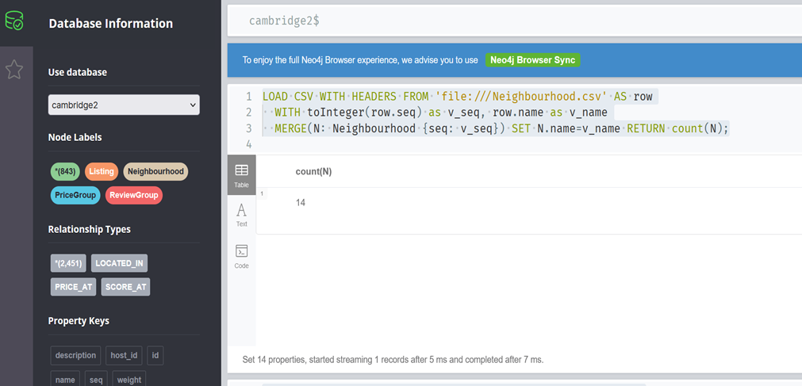
Data Load (Edges)
(5) Edges of PRICE_AT between Listings and Price Groups
LOAD CSV WITH HEADERS FROM 'file:///Listing.csv' AS row
WITH toInteger(row.id) as ListingID, toInteger(row.PriceSeq) as nPriceSeq, toInteger(row.Price) as nPrice
MATCH (l:Listing),(p:PriceGroup) WHERE l.id=ListingID AND p.seq=nPriceSeq
CREATE (l)-[r:PRICE_AT {weight: nPrice}]->(p) RETURN COUNT(r);
# match (l:Listing)-[r:PRICE_AT]->(p:PriceGroup) delete r;
(6) Edges of SCORE_AT between Listings and Review Groups
LOAD CSV WITH HEADERS FROM 'file:///Listing.csv' AS row
WITH toInteger(row.id) as ListingID, toInteger(row.ReviewSeq) as nReviewSeq, toInteger(row.ReviewScore) as Score
MATCH (l:Listing),(s:ReviewGroup) WHERE l.id=ListingID AND s.seq=nReviewSeq
CREATE (l)-[r:SCORE_AT {weight: Score}]->(s) RETURN COUNT(r);
# match (l:Listing)-[r:SCORE_AT]->(s:ReviewGroup) delete r;
(7) Edges of LOCATED_IN between Listings and Neighbourhood
LOAD CSV WITH HEADERS FROM 'file:///Listing.csv' AS row
WITH toInteger(row.id) as ListingID, toInteger(row.NBSeq) as nNBSeq
MATCH (l:Listing),(n:Neighbourhood) WHERE l.id=ListingID AND n.seq=nNBSeq
CREATE (l)-[r:LOCATED_IN]->(n) RETURN COUNT(r);
# match (l:Listing)-[r:LOCATED_IN]->(n:Neighbourhood) delete r;

Slide 10
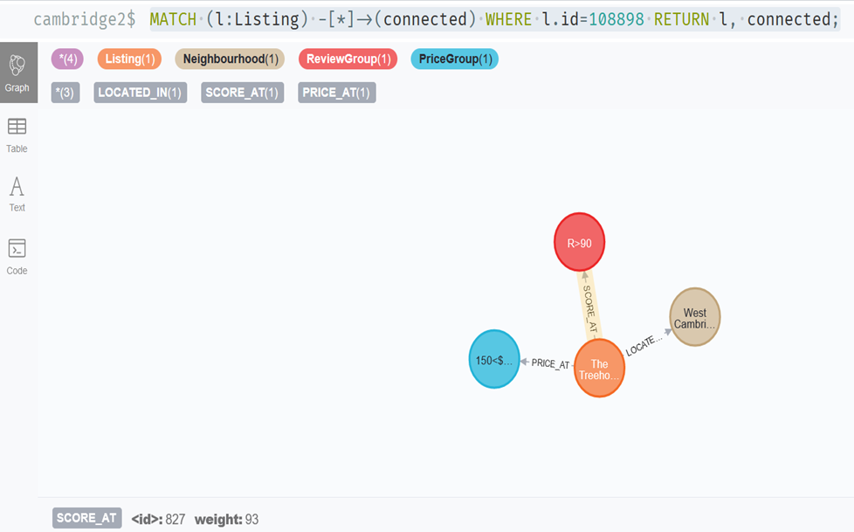
Data Verification
given one listing, show its raw data relationships
MATCH (l:Listing) -[*]->(connected) WHERE l.id=108898 RETURN l, connected;

Slide 11
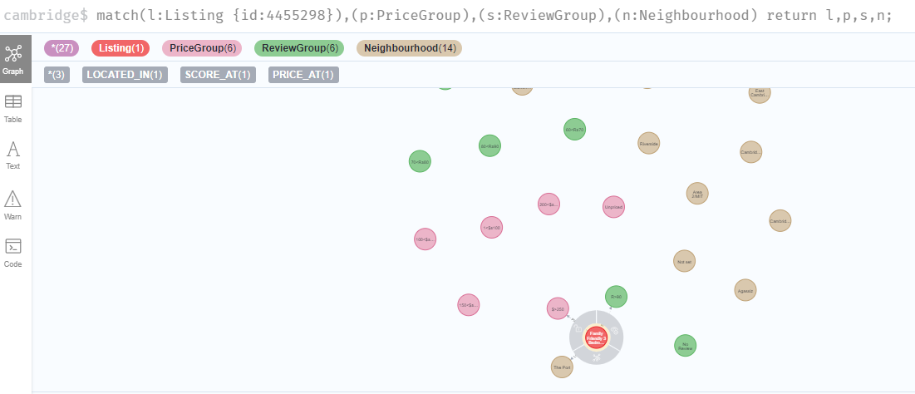
Cypher Query1
(1) Query a listing with its edges to price group, review group, and neighborhood match(l:Listing {id:4455298}),(p:PriceGroup),(s:ReviewGroup),(n:Neighbourhood) return l,p,s,n;

Slide 12
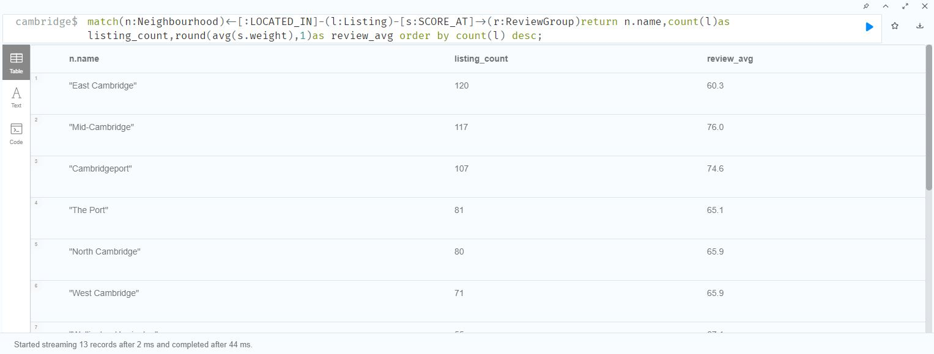
Cypher Query2 Totally there are 14 geographically spread neighborhood in Cambridge, MA for Airbnb to detail divides the city level regional market. Below shows the neighborhood along with their listing count.

Slide 13
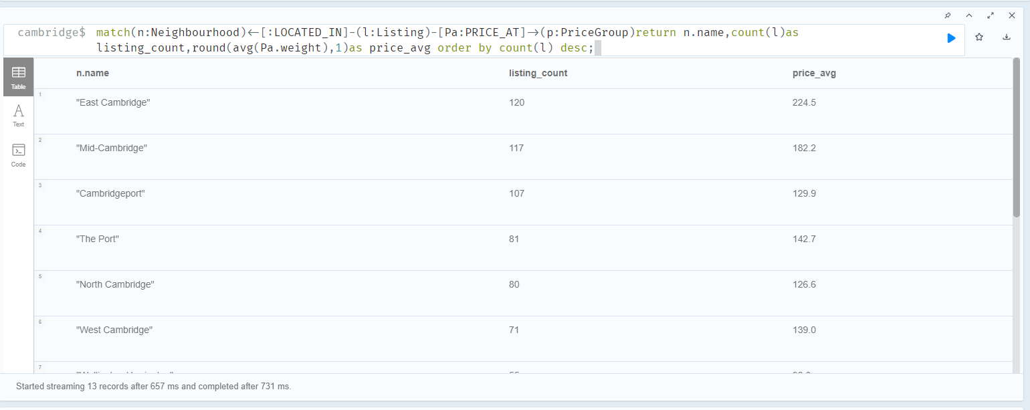
Cypher Query3 match(n:Neighbourhood)<-[:LOCATED_IN]-(l:Listing)-[Pa:PRICE_AT]->(p:PriceGroup)return n.name,count(l)as listing_count,round(avg(Pa.weight),1)as price_avg order by count(l) desc;

Slide 14
Analysis
Among the top three large neighborhood in terms of listing numbers, the East Cambridge is carrying the almost lowest review score. From business point of view, this is the one needs more attention, actions should be taken:
Investigating the reason for low satisfaction;
Giving more training to the owners in this area;
Tightening the acceptance criteria of new listings;
Follow-up analysis could be performed with future 6-month data compare with this result to verify if the actions are effective or not.

Slide 15
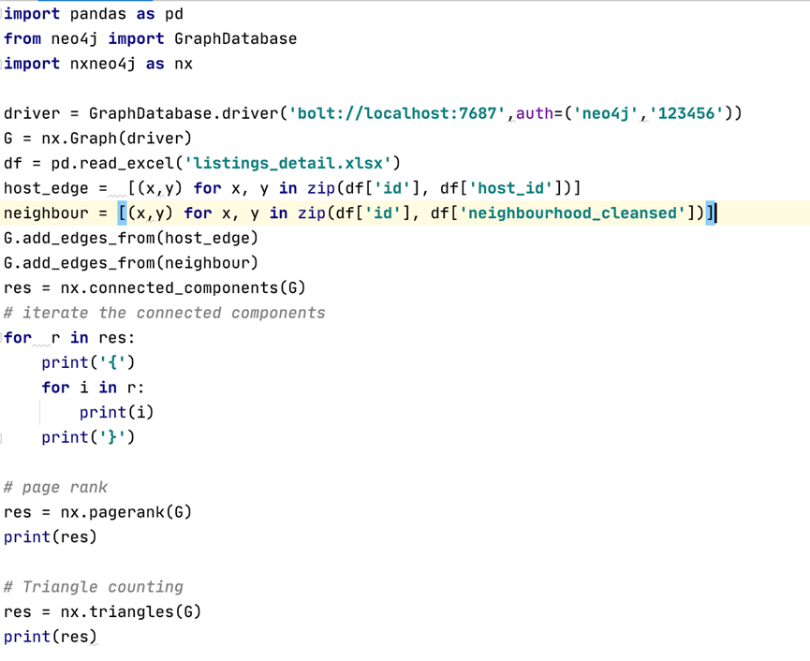
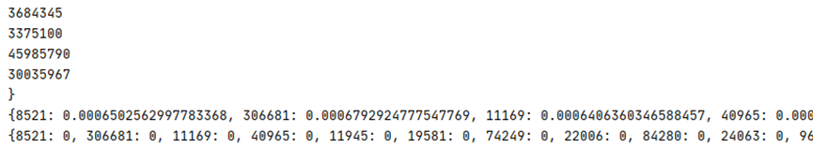
Algorithms

Slide 16
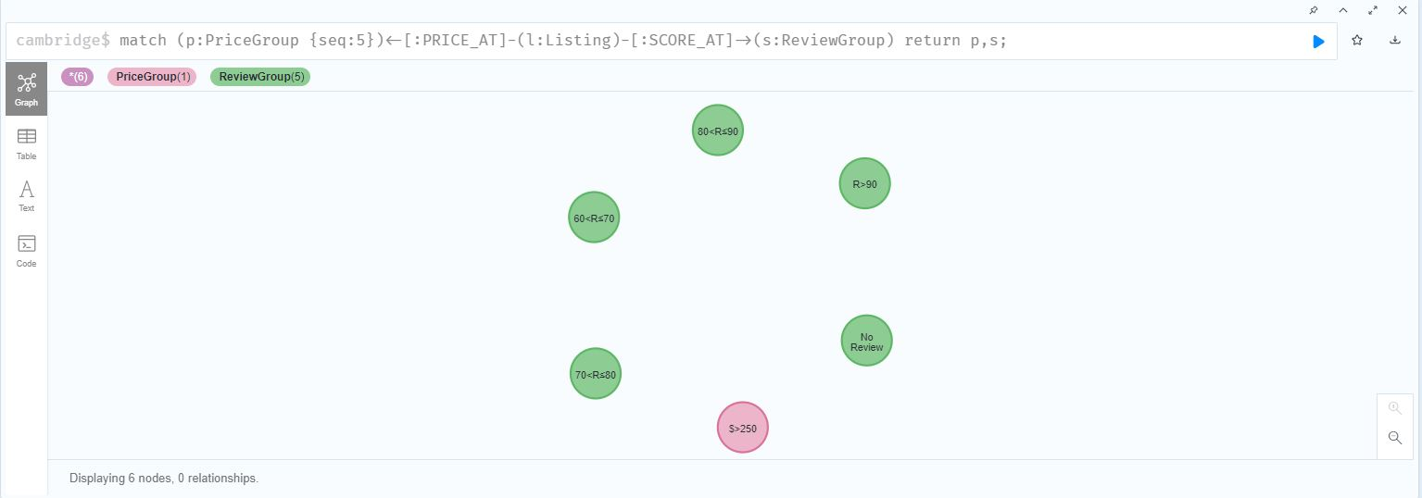
Cypher Actions1
Query how many review groups are corresponding to a price group match (p:PriceGroup {seq:5})<-[:PRICE_AT]-(l:Listing)-[:SCORE_AT]->(s:ReviewGroup) return p,s;

Slide 17
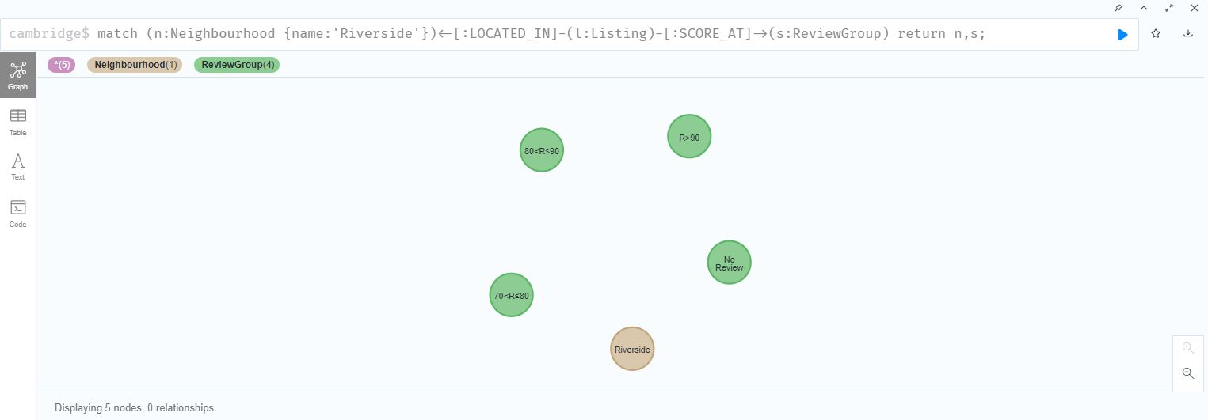
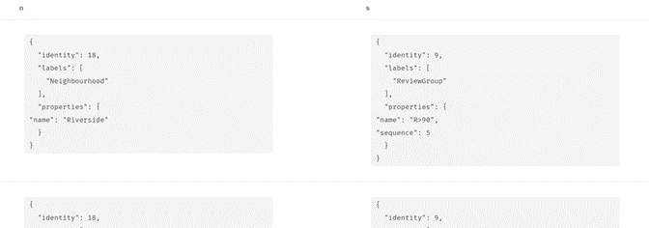
Cypher Actions2
How many review groups are corresponding to a neighbourhood match (n:Neighbourhood {name:'Riverside'})<-[:LOCATED_IN]-(l:Listing)-[:SCORE_AT]->(s:ReviewGroup) return n,s;

Slide 18
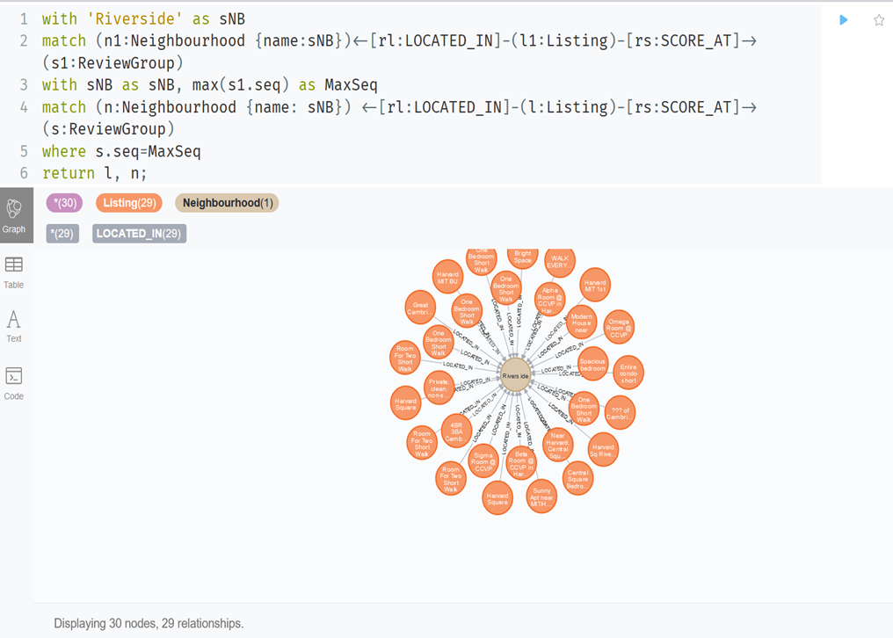
Visualization 1 (1) Given a location (Neighborhood), show me the listings in the best review score group, so I can consider them on higher priority.

Slide 19
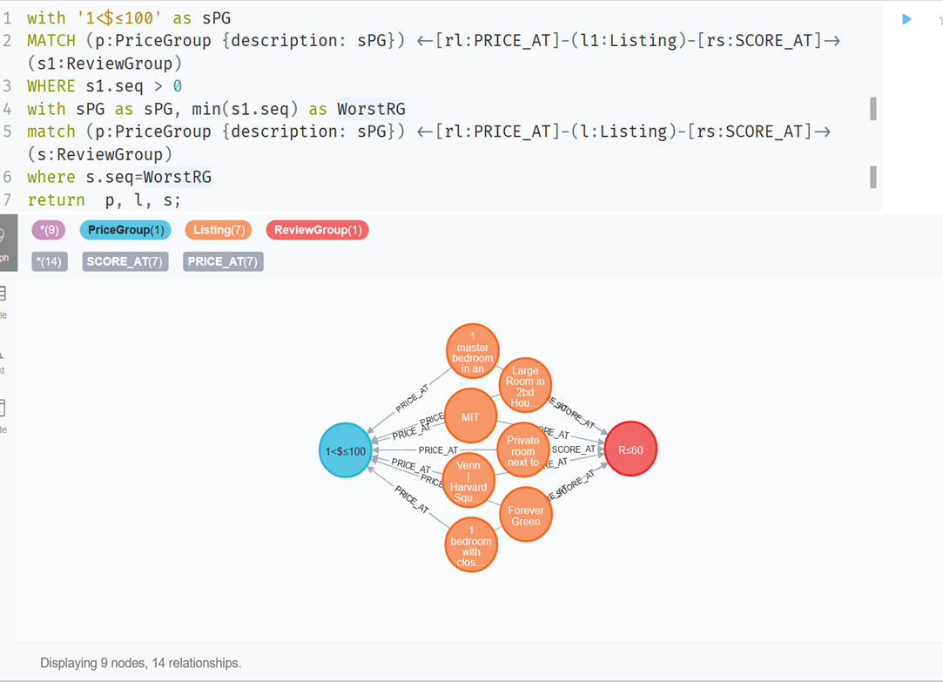
Visualization 2 (2) Given a price (Price Group), show me the listings within worst review score group, so I can avoid to book them.

Slide 20

Q & A

